Slide 1
Smart Home Security System Using IoT Technology
CEIS101 Final Course Project
Sempter2024
Jacob Davis
Prof. William Hinkle

Slide 2
Introduction
Overall Project Description: This project involved creating a smart home security system using IoT technology to enhance safety through motion detection and automated controls.
Objective of the Project: The objective was to develop an affordable, user-friendly security system that allows homeowners to monitor their property remotely.
Tools Used in the Project: Key tools included a microcontroller (Arduino or Raspberry Pi), Python for programming, motion sensors, cloud services for remote access, and LEDs and buzzers for alerts.

Slide 3
CEIS101 Module 2
Circuit Simulation in Tinkercad

Slide 4
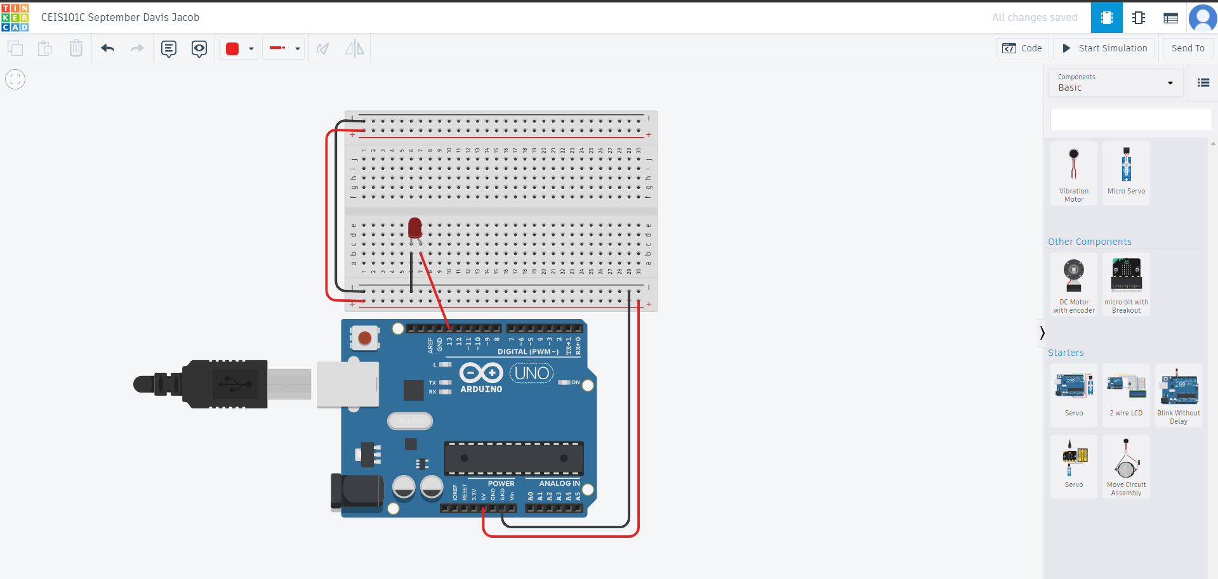
Circuit (screenshot)

Slide 5
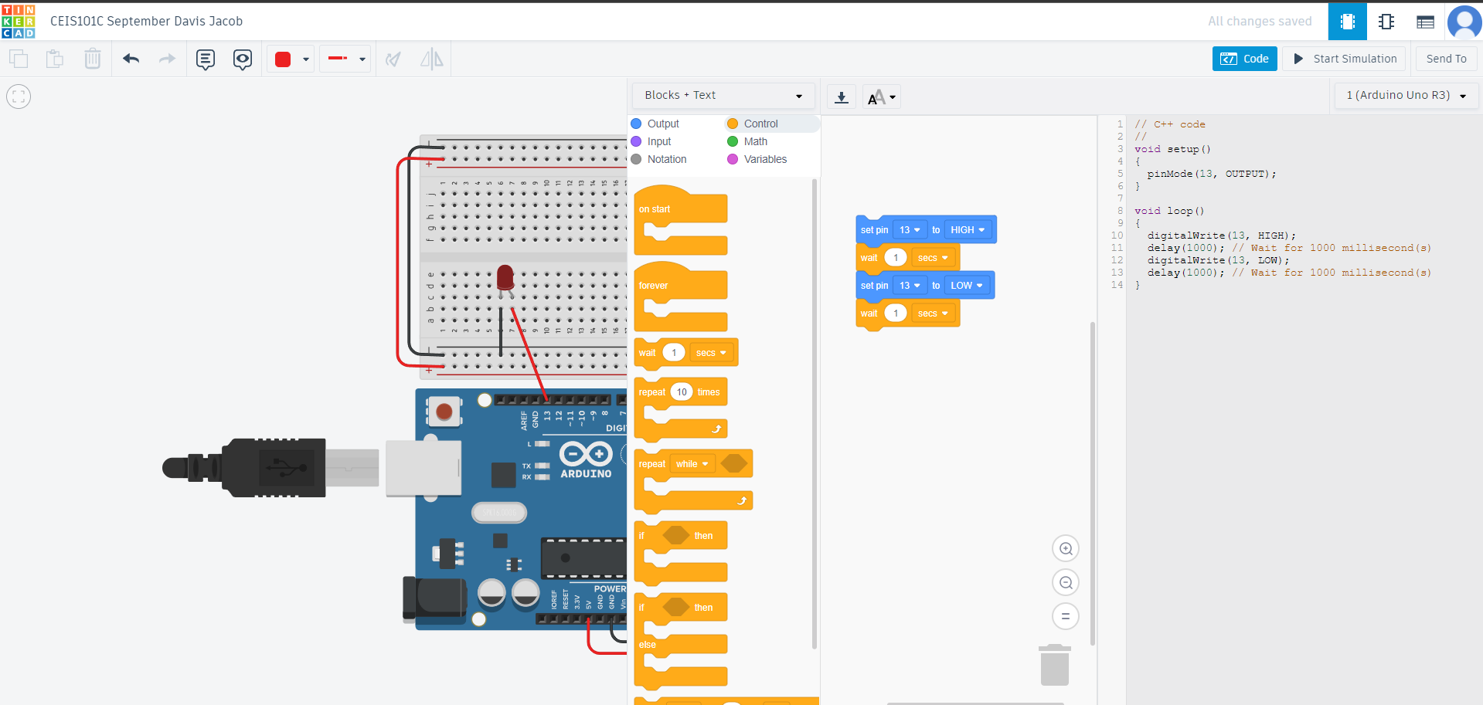
Code (screenshot)

Slide 6
CEIS101 Module 3
Inventory of Parts, Circuit Building, and Displaying Messages

Slide 7
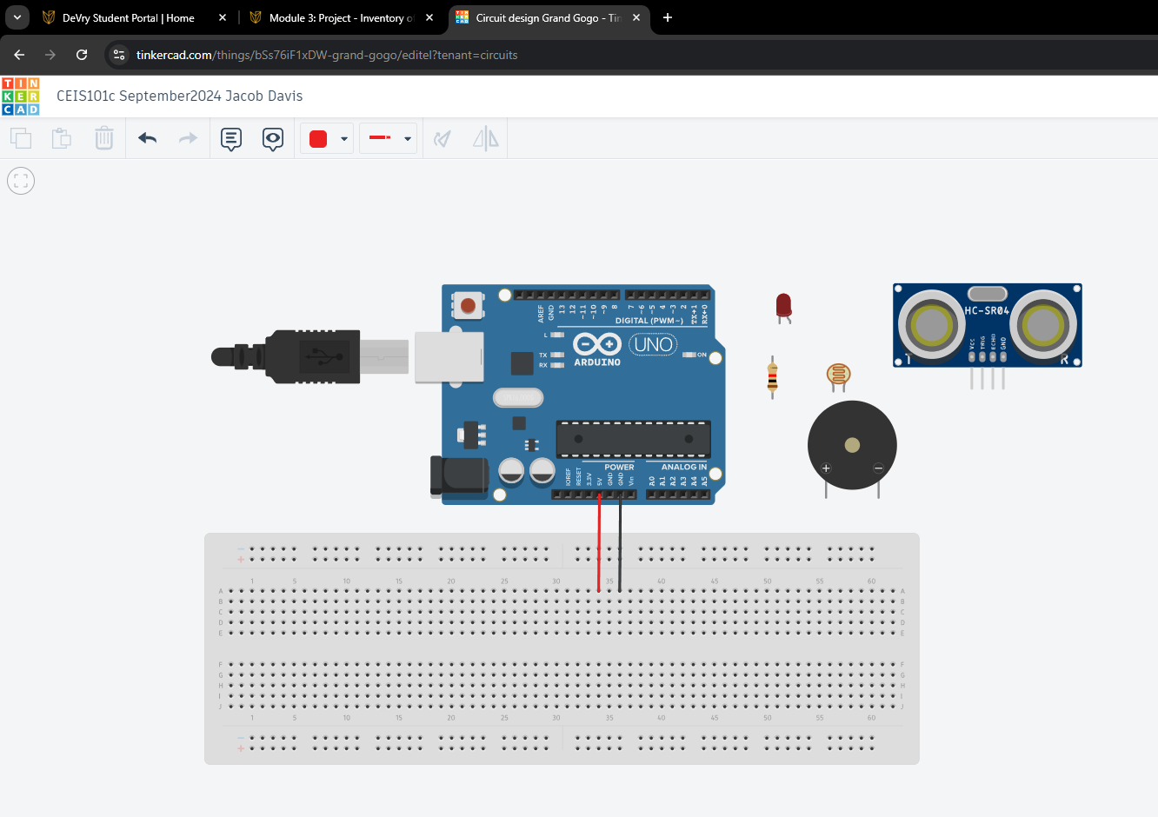
Organization of Project Components (picture)
Arduino Uno
Breadboard
Resistor 10kΩ
LEDs
Ultrasonic Sensor
Piezo
Photoresistor

Slide 8
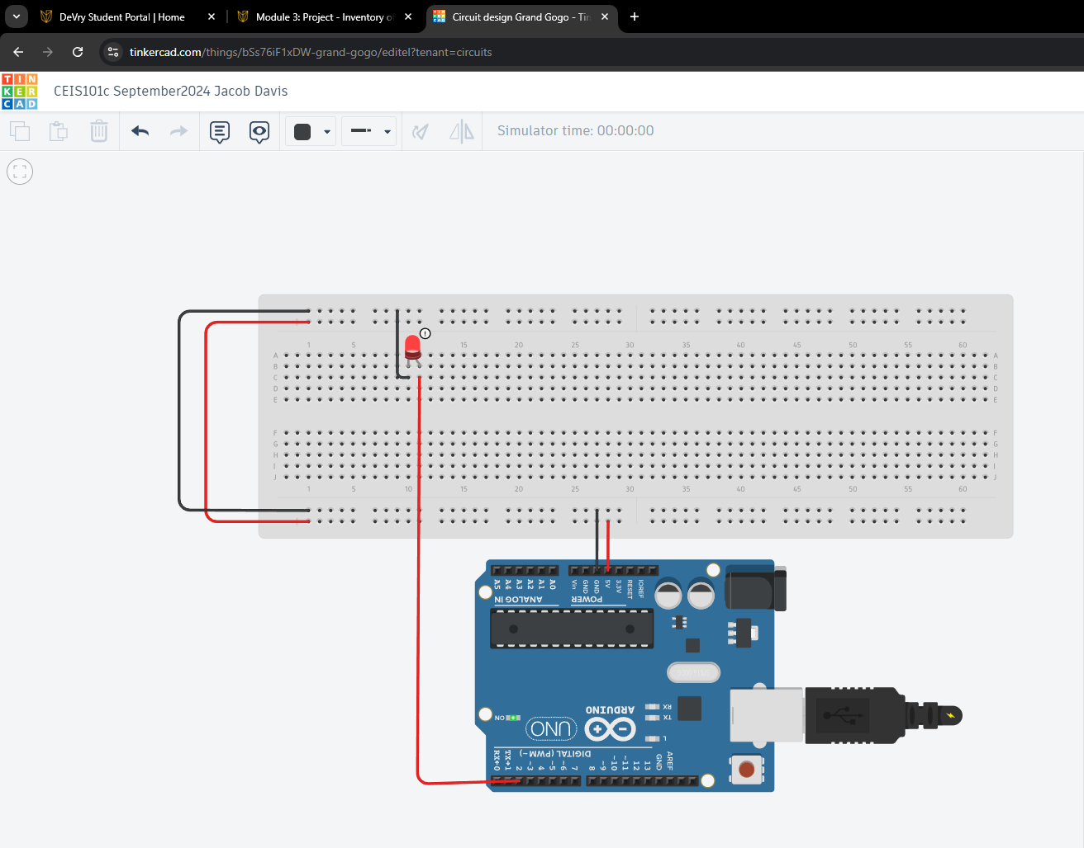
Circuit with red LED on (picture)

Slide 9
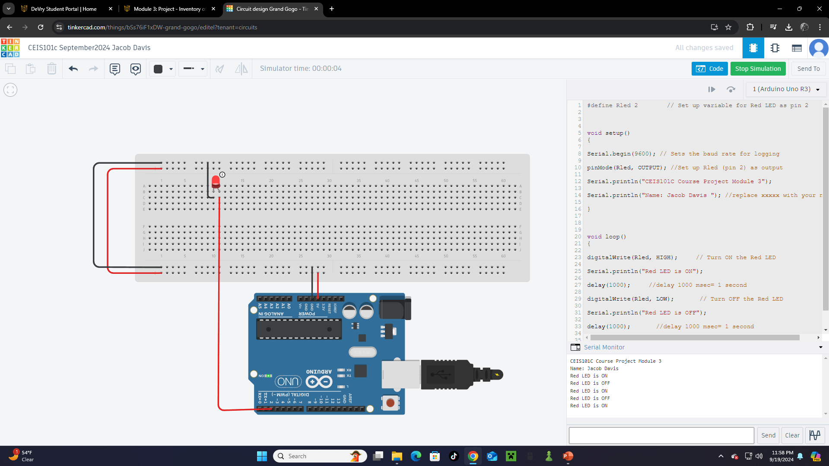
Serial Monitor (screenshot)

Slide 10
CEIS101 Module 4
Adding Door Sensor to Smart Home System

Slide 11
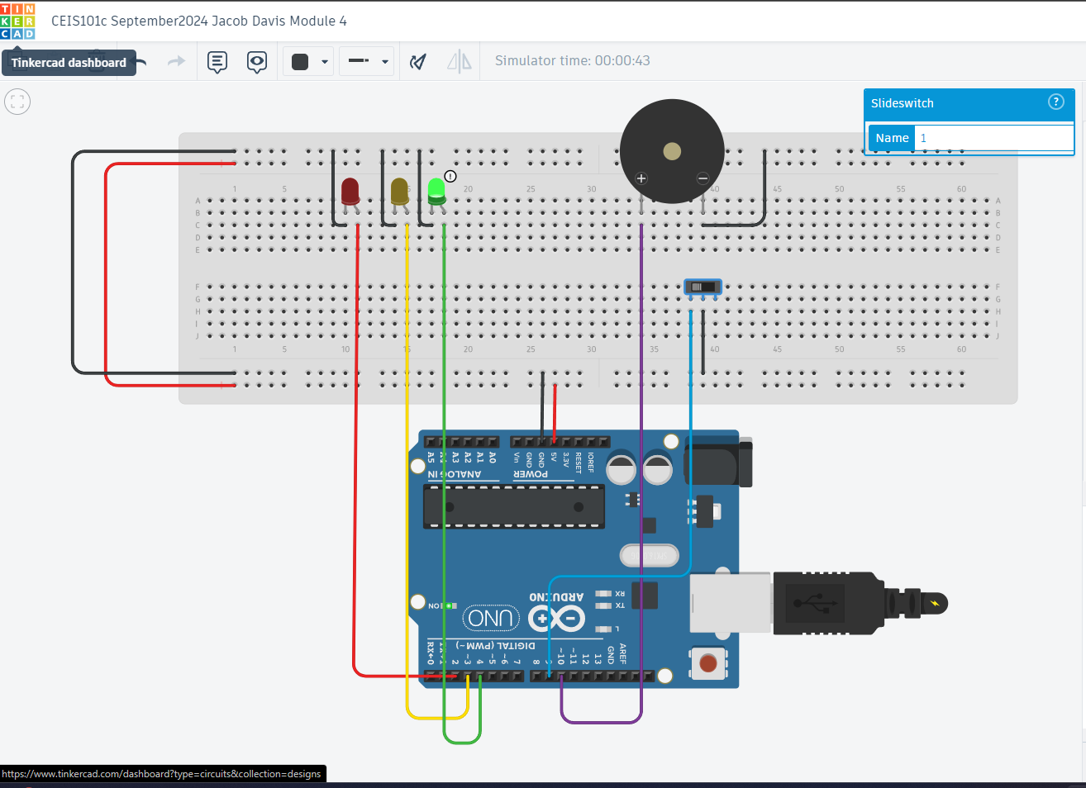
Circuit of door closed with Green LED ON (picture)

Slide 12
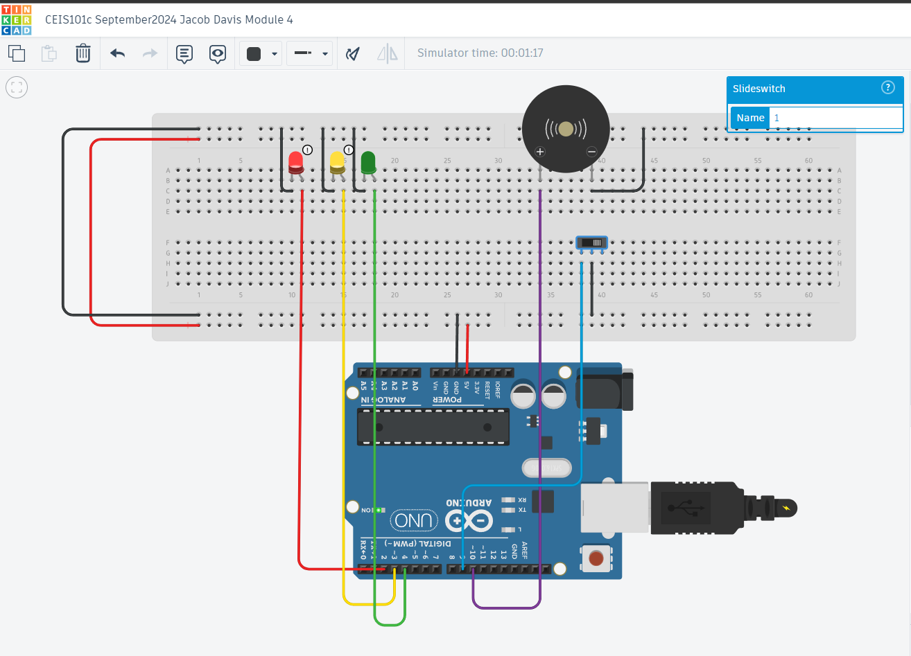
Circuit of door open with Green LED OFF (picture)

Slide 13
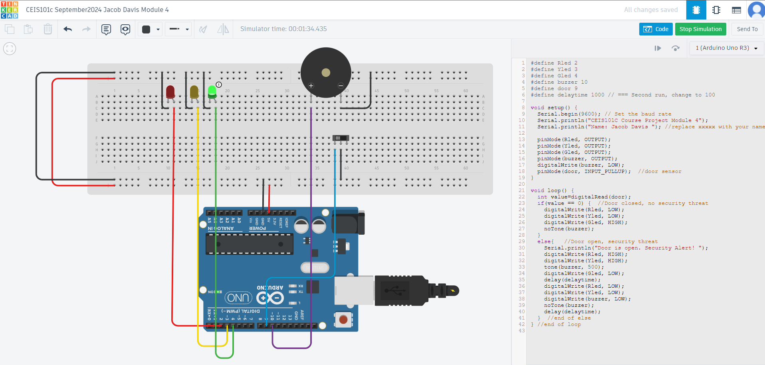
Arduino Code (screenshot)

Slide 14
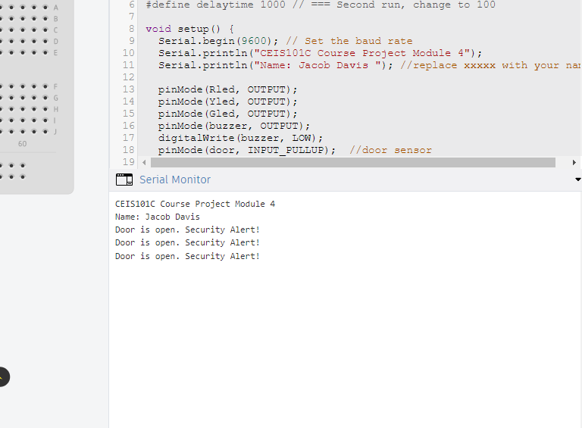
Serial Monitor (screenshot)

Slide 15
CEIS101 Module 5
Adding Distance Sensor to Smart Home System
and Conducting Data Analysis

Slide 16
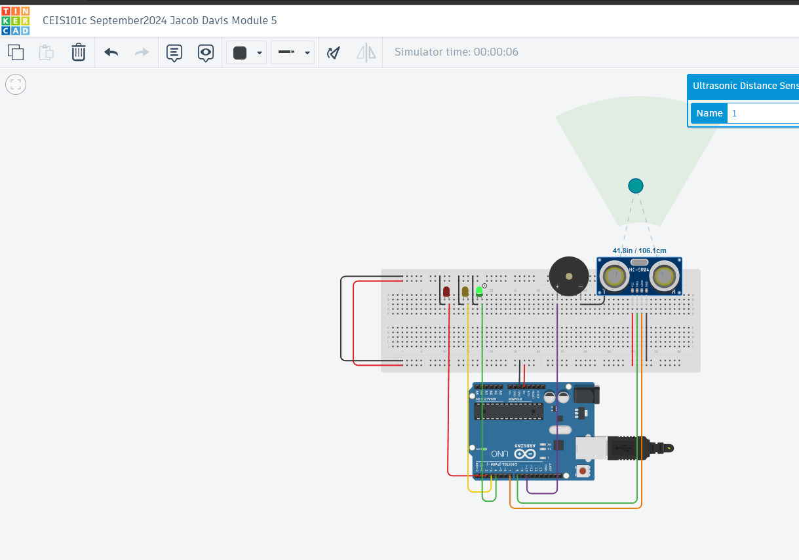
Circuit with green LED on (picture)

Slide 17
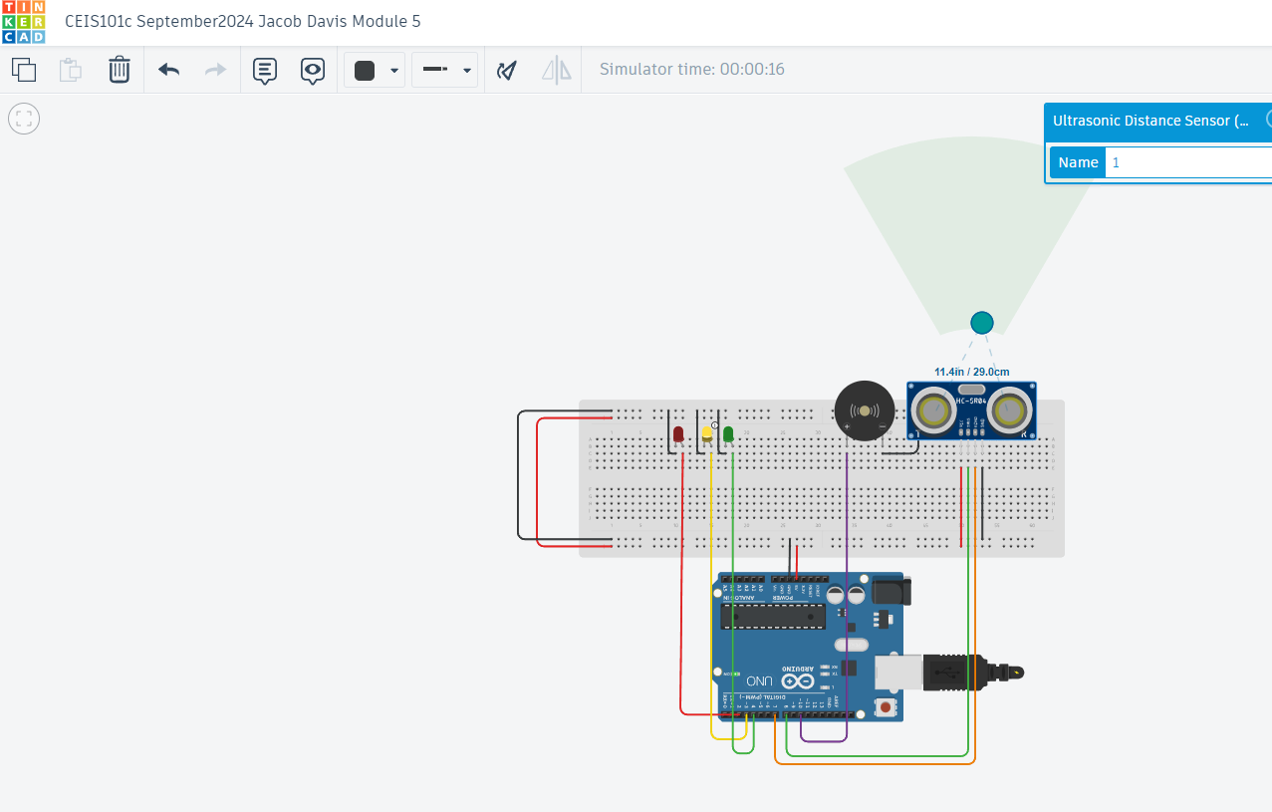
Circuit with yellow LED on (picture)

Slide 18
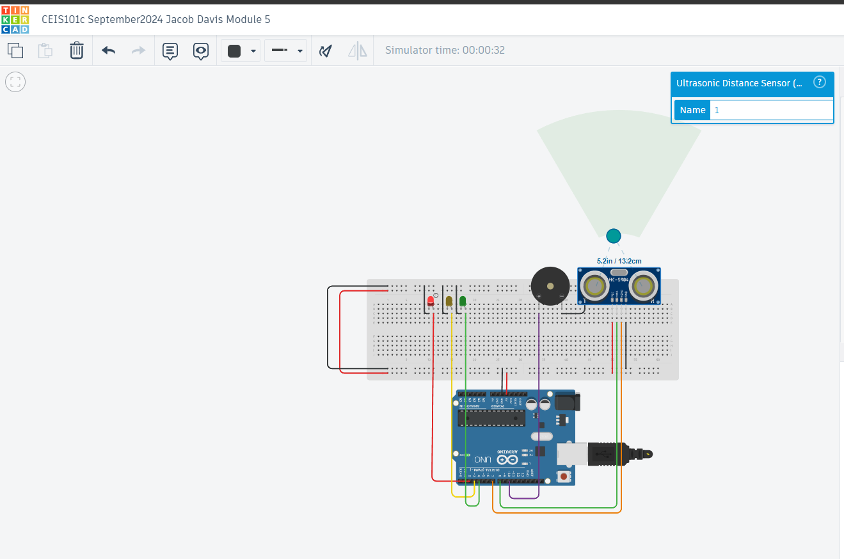
Circuit with red LED on (picture)

Slide 19
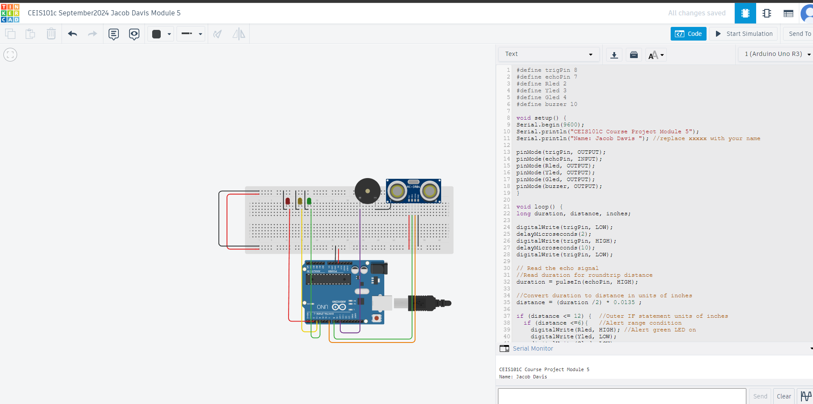
Arduino Code (screenshot)

Slide 20
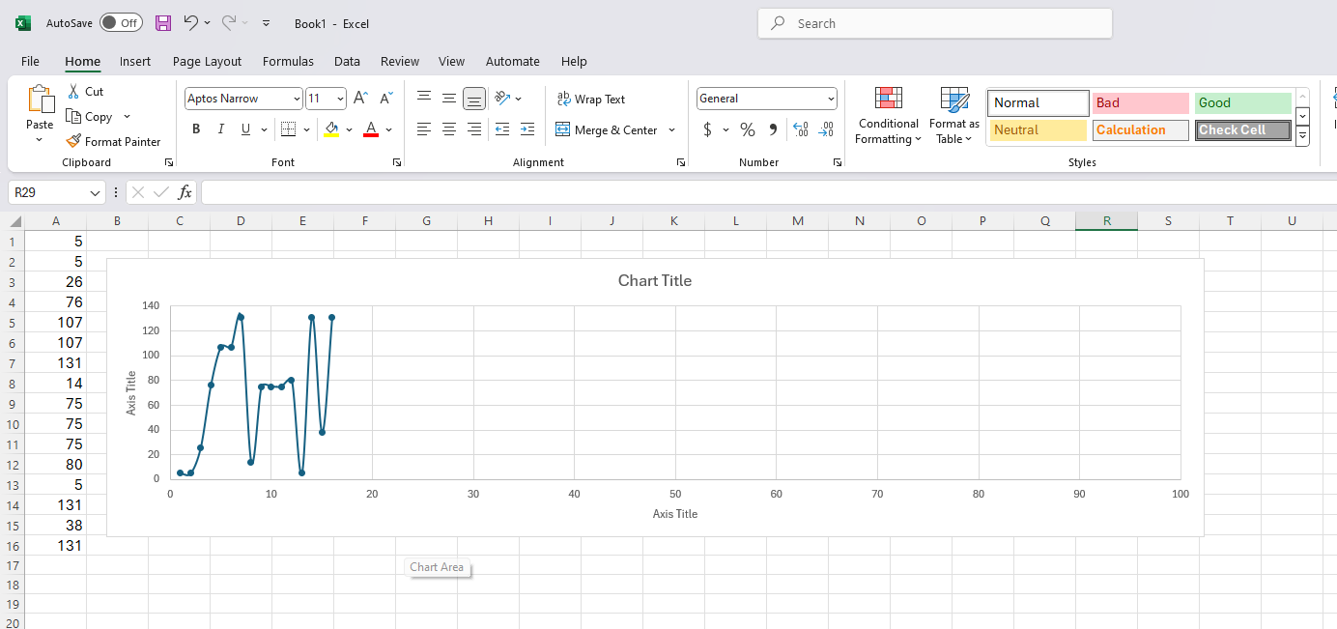
Plot of data (graph from Excel)

Slide 21
CEIS101 Module 6
Adding Automated Light to Smart Home System

Slide 22
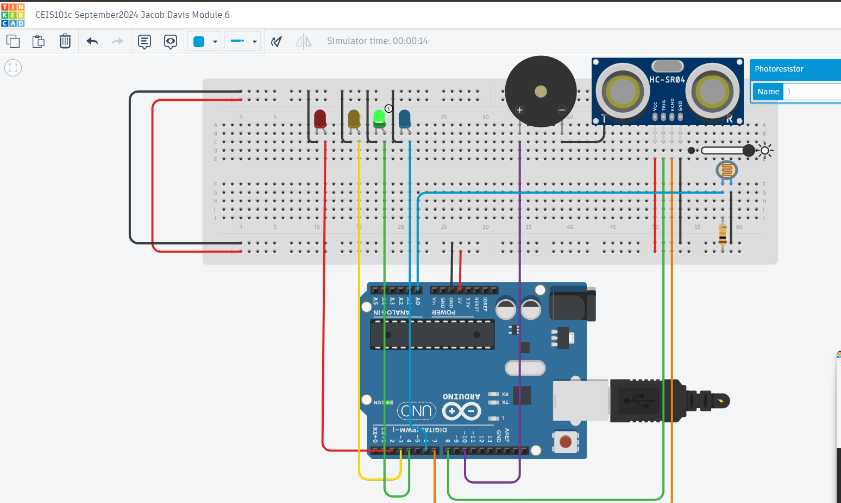
Circuit with automated LED off (picture)

Slide 23
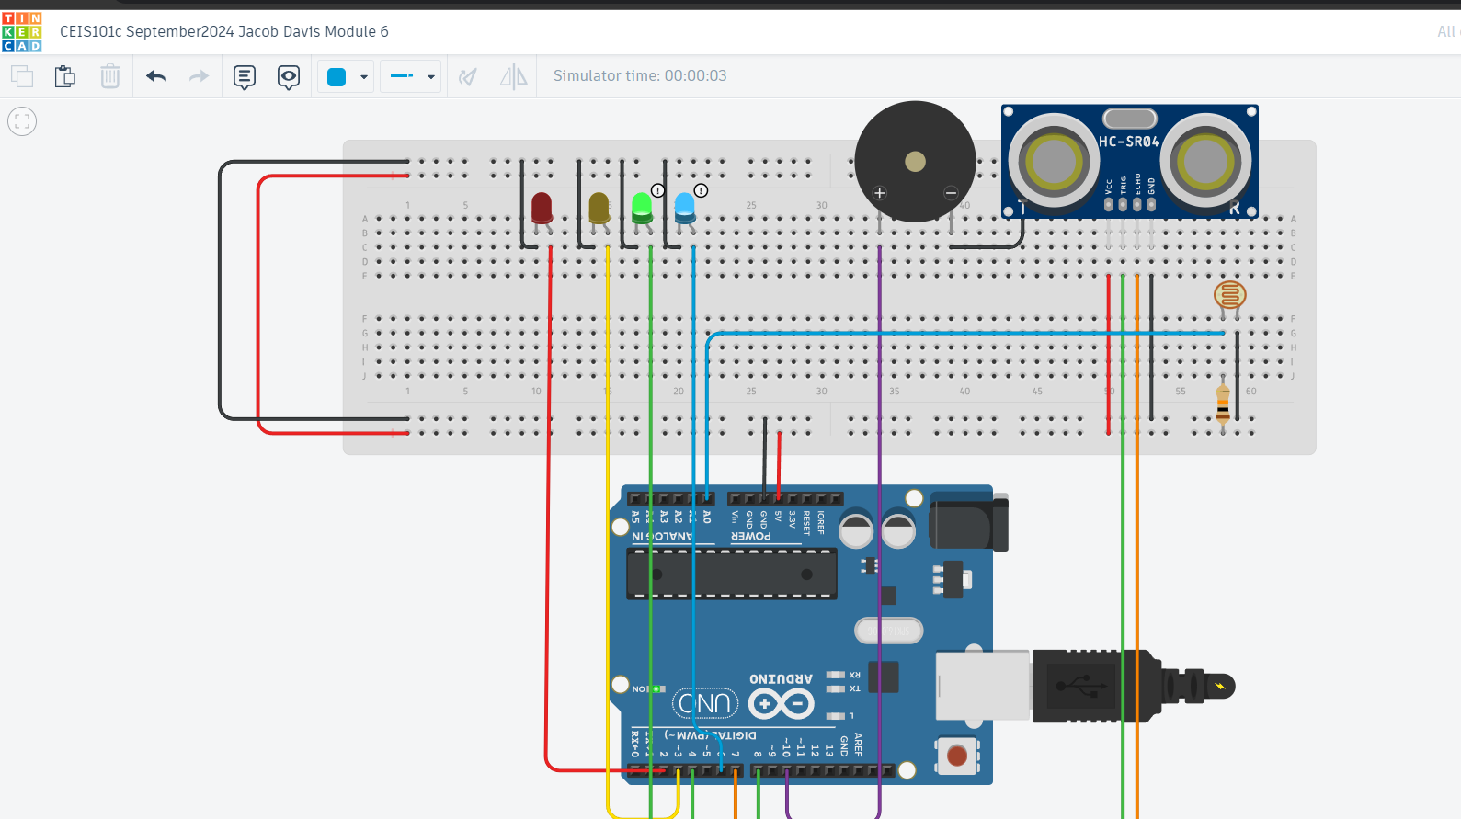
Circuit with automated LED on (picture)

Slide 24
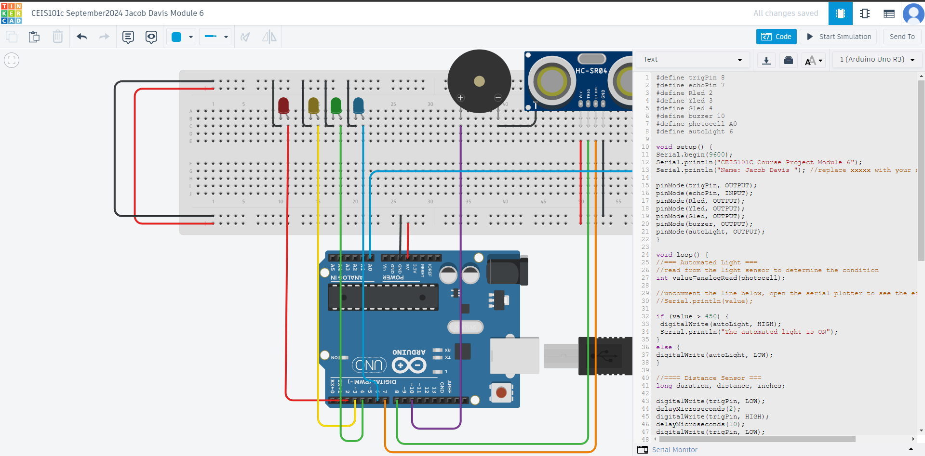
Arduino Code (screenshot)

Slide 25
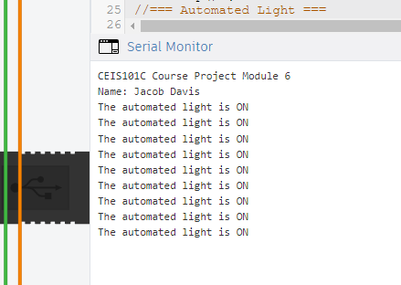
Serial Monitor (screenshot)

Slide 26
Challenges/Lessons Learned
What challenges did you face while working on the project?
Initially, there were difficulties in connecting the motion sensor to the microcontroller, which caused inconsistent behavior.
How did you overcome these challenges?
detailed documentation of the development process, which helped track changes and identify solutions more easily.
What lessons did you learn?
Regular testing and iteration are crucial for troubleshooting and ensuring functionality in complex systems.

Slide 27
Career Skills
What skills did you develop to benefit your career?
Gained experience in planning and executing a project, including setting milestones, managing time, and adapting to challenges as they arose.
What competencies will help you to gain the opportunities to advance your career?
Understanding data analytics tools and techniques can help in making informed decisions based on data insights.

Slide 28
Conclusion
The smart home security system project successfully demonstrated the use of IoT technology to improve home safety via motion sensing and remote access. It strengthened fundamental programming and electrical skills while focusing on problem-solving and cooperation. This experience not only prepares me for future technological problems, but it has also piqued my curiosity in learning more about IoT applications. Overall, it highlights the possibility of creative solutions that allow homeowners to improve their security.

Slide 29
References
I used the project videos and the resource guides for all projects

